Slide 1
Fall 2021
MIS 710
Process Innovation and Management
Individual Assignment
Reengineering the Record Management Process
I pledge on my honor that I have not given or received any unauthorized assistance on this assignment/examination. I further pledge that I have not copied any material from a book, article, the Internet or any other source except where I have expressly cited the source.
Signature: Kaushik M Rao Date: 05/11/2021
Print Name: Kaushik M Rao
Notes:
Supply Order Process

Slide 2
Assignment
1. Read and Assess the Current IS system
Functional specification
Relationship map
Process map
Data dictionary
2. Develop system
Organizational goals
Process goals
Narrative: functional/behavioral description
Change levers - Process constituents
Relationship map
Process map
2. Develop Design (continued)
g. Process Map /Sub-Goals
h. High-level database model
i. Activity Inputs/Outputs +
input screens, output reports
j. Function Goal Summary
k. Job (Role) Responsibility Matrix
i. Job (Role) Model Design
3. Costs & Benefits
(Not necessarily in dollar terms)
4. Summary
Main reengineering idea
Other processes impacted
Future evolution of system
Reengineering Homework
Notes:
Supply Order Process

Slide 3
Record Management Process:
1a. Brief Functional Description (IS)
XYZ, a large financial services firm, provides services across the world. Some of these services include wealth management, asset management, and investment. Due to the broad and expansive reach that XYZ has, the volume of corporate records the firm produces is extremely large.
In order to manage the archival, storage, and use of these records, XYZ has implemented records management departs throughout the organization. The Americas records management department, includes Puerto Rico, the United States, and Canada. The Americas team currently has ten members.
A key process within the organization is the records ordering process. This process has many steps and relies on a great deal of manual input. The first step of the process, is when the branch user places an order for a set of needed files. Once the branch user places the order, a records management team member receives an order notification.
Reengineering Homework
Notes:
Supply Order Process

Slide 4
Record Management Process :
1a. Current Process Evaluation (IS)
The current process leads to many manual errors, inefficiencies, and lost business opportunities. The as-is process forces the records management team member to utilize data input that was manually entered by branch users. Then, they are required to manually enter that data, when placing the orders with the vendor, as well as when recording order information in the local database. Due to a lack of automation, this increases the likelihood of errors. As a result, the current process has an error rate of 10 percent.
The current cycle time, which in this case is the time a branch user places an order for records to then they receive the requested files, is 24 to 36 hours. This is largely unrelated to the department’s process, as the cycle time is dependent of the vendor’s processes and resources. The cost of the current process is tremendous, due to the high number of staff members. Currently there are ten members on this team, translating to a $600,000 staffing cost. Due to manual nature of this process, the team needs many individuals to process these orders.
Reengineering Homework
Notes:
Supply Order Process

Slide 5
Record Management Process :
1a. ctd. Current Process Evaluation (IS)
A key business opportunity that is lost is that the staff is forced to focus on work that is very process-oriented and does not require much brain power. The inefficient process takes away time that the team members could be focusing on projects that require more strategic thinking and knowledge work, and instead is being consumed by tasks that could be simply automated.
Another business problem to consider is the legal nature of the work. Much of records management is governed by information governance. If corporate records are maintained and retrieved according to internal and government policy, this can leave the firm open to extensive legal damages. A more automated and structured process will allow the firm to be less liable, from a legal standpoint.
Reengineering Homework

Slide 6
Record Management Process:
1a. ctd. Brief Functional Description (IS)
Once the notification is received, the team member can enter an external vendor system, called IMConnect. Once the user is in IMConnect, they can place an official order for the records, based off of the information provided by the user. Once the official order is placed, the records management team member will receive an email confirmation.
Using the data from the confirmation, the team member will enter the local MS Access department database, and enter the order information. The next day, the team member will receive confirmation that the branch user has received the requested files and the order can then be reconciled in the database.
Reengineering Homework

Slide 7
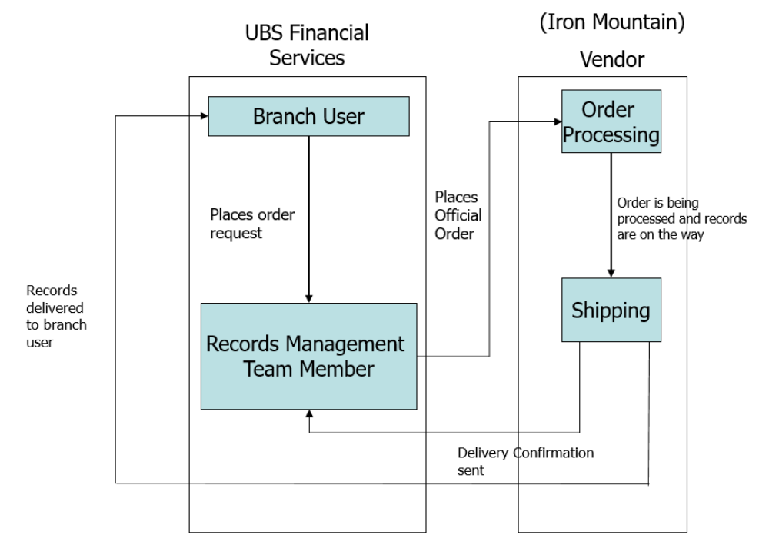
Record Management Process :
1b. Relationship Map (IS)
Notes:
Supply Order Process

Slide 8
Record Management Process :
1b. ctd. Relationship Map (IS)
The relationship map above defines the roles and responsibilities of every element which is a part of the AS-IS process and shows how each entity interacts with the other during the whole process. The above diagram shows the steps which are performed in the AS-IS process in order to satisfy the needs of the clientele.
We can see that the whole process earlier used to run through the Records Management Team and each team member who were responsible for various tasks were doing everything manually, be it accepting the client’s request to handling the request and completing the same. The whole process since it was done manually took a lot of time and cost XYZ an unnecessary overhead.
Reengineering Homework
Notes:
Supply Order Process

Slide 9
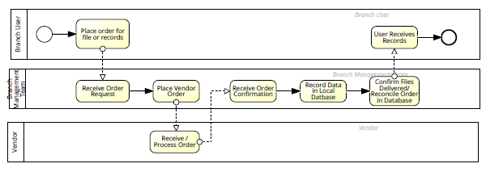
Record Management Process
1c. Process Map (IS)
Reengineering Homework

Slide 10
Record Management Process Some Essential 1d. Data Dictionary (IS)
From observation of current process forms, screens, reports, etc.
1. User name of the branch user for IMConnect (Vendor System)
2. Password of the branch user to login to IMConnect
3. User ID – Each user has an unique number
4. Record or file name and number to be ordered
5. Start date of the record ordered
6. End date of the record to be ordered
7. Signature of the user to verify the credibility of the user
8. Address for the record to be delivered
9. Order Id which is generated after the user places order
10. Time of placing order (Logged in the internal system)
11. Records management team Employee login credentials for PRIS (Internal System)
12. Real time Status of the order
13. Confirmation message to the user on successful processing of order.

Slide 11
Proposed New Design
Our New approach of reengineering is by using sales force management system
Reengineering Homework

Slide 12
Record Management Process : Rummler Matrix:
2a. Rummler Matrix: Organizational Goals
Rummler Matrix: Organizational Goals (SHOULD)
Operational Excellence: enhancing and improving the efficiency of the RIMS system by lowering the error rate from 30% to zero.
Improved Performance: By automating the data entering process, the current cycle time can be reduced from 24 hours to a few clicks.
Controlling overhead costs: By automating operations and reducing manpower, RIM can keep its service costs low. Instead of 10 people, the record management team can be decreased to three. There will be two team members and one project manager.
• Regulatory compliance: RIMS ensures that all regulations are followed by electronic data disposition by adhering to retention schedules and capturing the final product.
• Educate staff: Ensure that all employees are aware of the roles and responsibilities of what they are expected to do.
Reengineering Homework

Slide 13
Reengineered Record Management Process :
2b. Process Goals ()
Process Design Goal
Goal1: Optimizing approval layers to improve workflow.
Goal 2: Make the process more efficient by automating it.
Goal 3: Improving field-level security and privacy (allow the dependable exchange of pertinent records and data).
Goal4: cutting costs through automation.
Goal 5: Keeping records throughout their life cycle will help to facilitate short term planning.
Reengineering Homework
Notes:
Supply Order Process

Slide 14
Record Management Process :
Operating goals:
The RIMS system will be completed in three months. The initial design and cost will be evaluated within the first three weeks. Weekly anonymous feedback on the process's flexibility and success will be collected from Branch Users and the Record Management Team on the process's flexibility and success.
Reengineering Homework
Notes:
Supply Order Process

Slide 15
Record Management Process :
Functional Narrative (SHOULD)
To avoid ordering the same thing again, the branch user should double-check that they haven't already done so.
• When the branch user is satisfied, he or she submits a one-of-a-kind order for a set of required files on RIMS. When an order is placed, the Branch Manager receives an order notification. After careful study, the order is authorized.
• Once the order is accepted on RIMS, the Record Management team is notified. Depending on the importance of the demand, either a member of the Record Management Team or the Manager approves the "ORDER.“
• When the record management team on RIM approves the order, it is automatically transferred to IMConnect, where an order is c
Reengineering Homework
Notes:
Supply Order Process

Slide 16
Functional Narrative ()
• RIMS now receives the produced order ID, and the "ORDER ID" and "Requested date" entries are updated.
The mistake rate is almost zero because there is very little human interaction.
• Once the vendor delivers the order to the delivery location, the Branch user receives the files and the record management team receives the status notification.
• In addition, the RIMS is updated with statistics on delivery dates and times.
Reengineering Homework

Slide 17
Record Management Process :
2c. ctd. Behavioral Narrative ()
The Branch users places an order then Branch manager approves the request or declines the request. Then after the order is approved by the branch manager then the approved request is sent to RIM system. Then Record management team approves the order or declines the order accordingly. If it is declined the request is sent back to branch user. If it is approved the request is sent to vendor system(IMS connect. After the order is processed the notification is sent back to record management team. Then the user receives the
Notification.
Reengineering Homework
Notes:
Supply Order Process

Slide 18
Record Management Process:
2d. Change Levers/Process Constituents
Record Management
Structure
Human
Information
Tools
Organizational Structure (Changes in Departments, etc.):
The IT support staff must work closely with branch users and the record management team to fully comprehend the record management process. This is a long-term partnership that began with the RIMS' initial design and execution.
The IT support department should be available 24 hours a day, 7 days a week to verify that record backups are completed correctly and also make sure that 100% compliance is achieved. Human beings (managers, operators, role changes, etc.)Branch users and members of the Record Management staff should be trained on their tasks and obligations on a daily basis.
The record manager's role must be broadened, and he must be able to recognize all scenarios and actions that must be taken if the record management team accepts an incorrect order.
Reengineering Homework
Notes:
Supply Order Process

Slide 19
Record Management Process
2d. ctd. Change Levers/Process Constituents ()
Information Structure (data bases, reports, etc.)
•The Orders are stored in a single unified database, making it easier to fetch data and generate reports.
•The Branch User team and Record Management team must become more unified with Information Systems.
Tools (equipment, software systems, etc.)
Instead of MS Access Database, Salesforce, an integrated CRM platform, is used. Salesforce has a robust set of reporting features that can be used in this situation.
The Record Management Team can generate reports depending on branch, month, and other criteria. This strong reporting strategy will make data more understandable and accessible.
The Record Management team will no longer have to manually enter data because the MS Access database will be replaced with a single unified database.
One of the newest elements of the RIM system will be a one-click approval model process. In-app alerts for approval or deletion will be triggered by the workflow email alert.
Reengineering Homework
Notes:
Supply Order Process

Slide 20
Consistency Checks to Date - 1
All of the organizational entities described in the narrative should be included in the Change Levers and Relationship Map. Human entities/roles in the plot should be depicted in the Change Levers. The information flows indicated in the Narrative should be depicted on the Relationship Map
Reengineering Homework

Slide 21
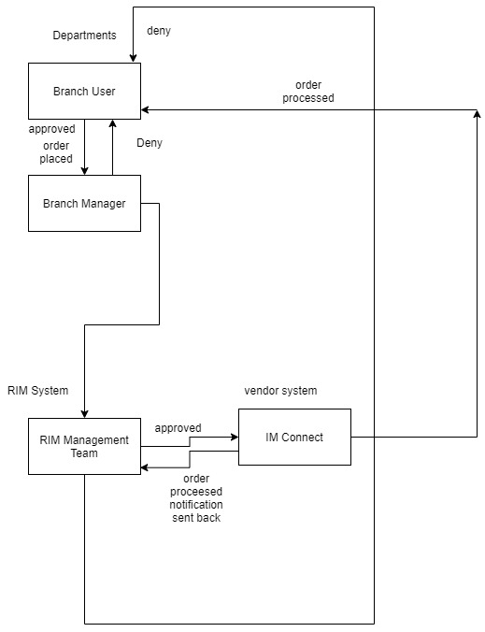
Record Management Process :
. Rummler Relationship Map
Notes:
Supply Order Process

Slide 22
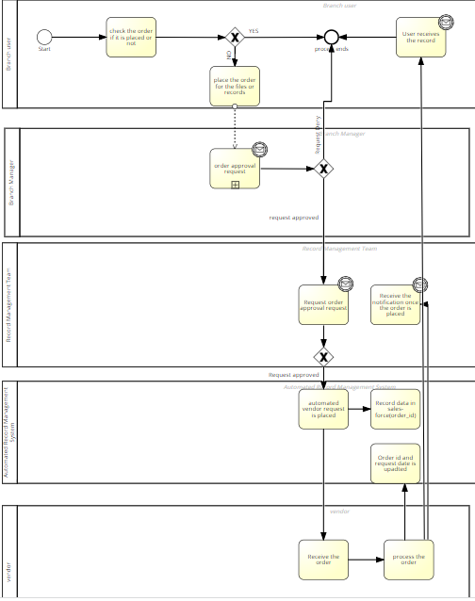
Record Management Process :
2f. Process Map () – Use Signavio BPMN
Notes:
Supply Order Process

Slide 23
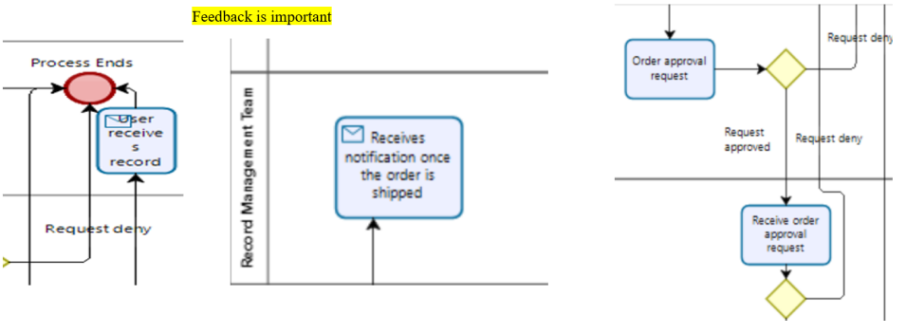
Record Management Process
2g. Task Sub-Goals ()
Repeat process map showing the task/activity sub-goals that are needed to realize the overall process goals.
Reengineering Homework
Notes:
Supply Order Process

Slide 24
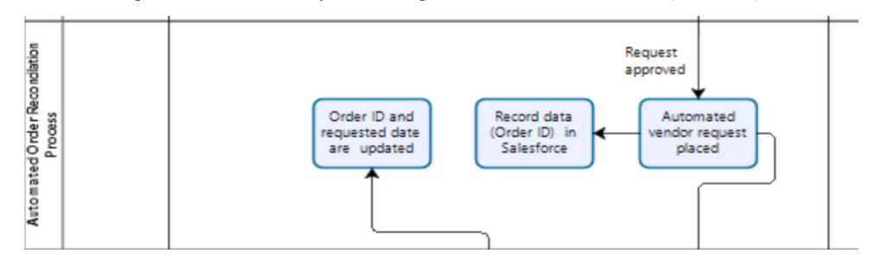
Operational excellence by order reconciliation process (Sales force_)
Reengineering Homework

Slide 25
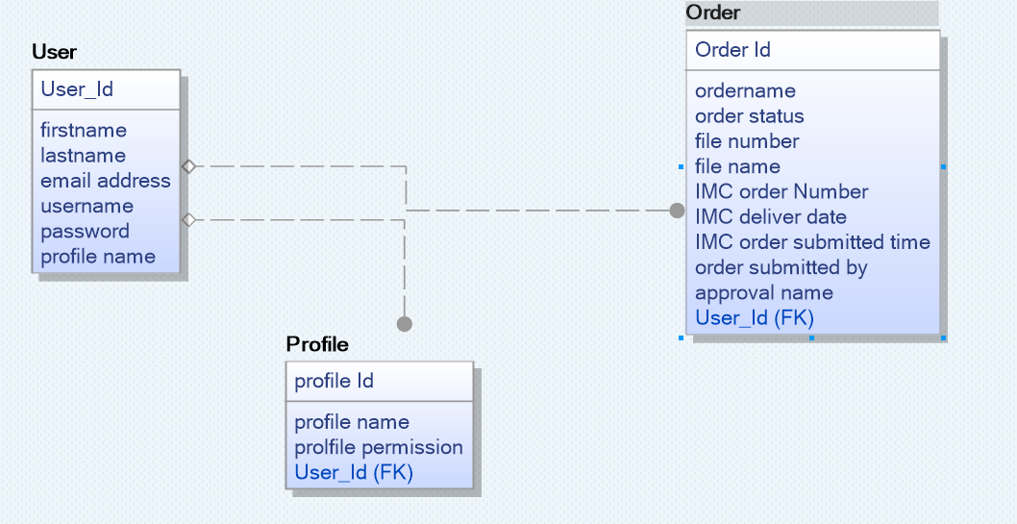
Record Management Process
2h. Relational Data Model ()
Reengineering Homework
Notes:
Supply Order Process

Slide 26
Record Management Process
2i. Information View: Activity DATA Inputs/Outputs for two activities
(Data items NOT activity steps)
Record Management Team Approval
Inputs: Order received for approval by branch manager | Outputs: Order approved Order automatically sent to IM connect. Upon request completion by IM Connect. Notification is sent to both Branch user and record Management team and dates are updated
Branch User places an order
Inputs: File Name and File Number Deliver address | Outputs: Check for the duplicate's orders Order sent to approval address to branch manager
Reengineering Homework

Slide 27
Record Management Process
2i. ctd Information View: Input (Data Entry) Screen(s)/Form(s)
Refer slides from 36 to 54 for the output screen
Reengineering Homework

Slide 28
Record Management Process
2i. ctd. Information View: Output Screen(s) / Report(S)
Refer slides from 36 to 54
Reengineering Homework

Slide 29
Record Management Process
2j. Operational View: Functional Goal Summary
1)Automate the data 1)No manual data entry 1) We should control the 1) RIMS system uses salesforce application to make record management entry process process is required since overhead expenses by process flexible and user friendly. it is automated this brings reducing workforce error rates to zero 2) One click approval 2) Reduced work force 2) Educate the employees 2) Send automated emails to approvers and requesters .process for branch due to automation to ensure that they record Manager and record management process, Management team roles and obligations. 3) Self reporting and 3) Enhanced the flexibility Record approval system In case if the request is defined notification will be sent back to branch user branch reporting by making the approval available on time Available process available on time
Department Jobs & Responsibilities
Major Process
Steps
Outputs
Goals
Reengineering Homework
Notes:
Supply Order Process

Slide 30
Record Management Process
2k. Operational View: Job/Responsibility Matrix
1) Request to 1) Based on the 1)once the order is 1) Record the team 1) Operational 1) review and 1) Fastened verify if accessed the verification placed the order reviews the order excellence process the order process the same record branch user proceeds goes to branch request and make 2) improvised received by the 2) increased or not. to place new order manager for the decision work flow record management accuracy approval team 2) Extra approval 3) overhead cost process reduces reduction 2) Notification is sent error rates. to branch user and record management team with delivery status
Job Responsibility Matrix
Process Steps | Employee |  | Manager |  | Etc.
 | Accomplishments | Goals | Accomplishments | Goals | Accomplishments | Goals
Reengineering Homework
Notes:
Supply Order Process

Slide 31
Record Management Process
2l. Operational View: Job (Role) Model (Design)
ROLE: Record Management Team Process: Approved order Verify if the order details is approved by the branch user and branch manager Ordered work flow management Duplicates orders is not placed system by the branch user On receiving the order request due to Fastened process as no manual work Atleast 3 people from the automation a one click approval process is is involved technical team must be on call followed without manual intervention the order at one time(primary and backup is passed on to IMS Connect team member is things fail) Mobile application available to Mandatory report generation approve so we don’t need computer by weekly basis so that we can always come to know which branch places maximum orders.
ACCOMPLISHMENTS SUBACCOMPLISHMENTS | CRITICAL DIMENSIONS | MEASURES | STANDARDS
 | Accuracy Timeliness
Reengineering Homework
Notes:
Supply Order Process

Slide 32
Record Management Process :
3. Costs & Benefits
Implementation Costs
•Since Salesforce is hosted in the cloud, there are no expenditures associated with server hardware infrastructure .
•Licensing fees for server software.
•The number of support personnel can be reduced. Because all data entry work is completed between the hours of 10 a.m. and 3 p.m.
Operating Costs:
•The expense of hiring a Salesforce consultant and developer to build the site and work on the API exchange was an early cost.
Benefits:
Tangible Benefits
•Reduce the number of man hours required to process orders
•Reduce the number of errors made throughout the data entry procedure.
•Reduce the time it takes to complete an Order request.
Intangible Advantages:
•Reduce the amount of stress in the workplace.
•Reduce the number of busy workdays.
•Improve the happiness of branch users.
Reengineering Homework

Slide 33
Record Management Process :
4a. Major Reengineering Idea
The major Reengineering idea is by using sales force cloud for automating the process.
Through this process instead of hiring 10 people for the work we can finish the work with 3 employees.
Before this process used to be manual and used to takes lots of time. Through this new process we can save lots of time.
Through this new process Branch user can come to know if the request is rejected or approved through notification.
We can also determine if duplicate requests is placed is by the branch user or not.
Reengineering Homework
Notes:
Supply Order Process
1) Removal of Disconnects (Rummler)
Eliminating Duplicate Work
• Multiple requesters no longer involved in invoicing and payment; centralized in A/P via purchasing system
Eliminating Illogical / Extraneous Steps
• Removed chance of supplier invoicing customer
• Removes need for admin assistant (although this can still occur)
Inserting Missing Steps
• Established and used preferred vendors
• Request approvals for orders over a certain dollar amount
• Establish A/P as central place to receive invoices
• Check and balance invoice against purchase system to ensure correct quantity and price match
2) Impact of IT (Davenport)
Automational (eliminate human labor)
• Purchasing system allows automatic verification of invoice and authorization of payment
Informational (capture process info for purposes of understanding)
• System is central place for list of preferred suppliers
• System guides users, suppliers, and finance through the ordering process
• System allows easy budget reporting
Tracking (monitor process status and objects)
• System closely monitors:
O whether users use preferred vendors
o whether users order over their spending limit
o when orders are received from suppliers
o when invoices are received and paid
Analytical (improve analysis and decision making)
• Centralized checks and balances for budget approval levels
• Simplified budget reporting
Geographical (coordinate process across distances)
• System will be part of standardized process across J&J US sites
Disintermediating (eliminate intermediaries from process)
• Removes requestor as intermediary between supplier and A/P re: receipt of invoice
3) Business Process Reengineering Principles (Hammer)
Principle 4: Self Service
• Purchasing system allows users to order materials themselves without worrying about preferred suppliers and spending limits
Principle 5: Value Chain Redesign (work performed where it makes the most sense)
• Most of the process steps fall to A/P and the purchasing system, allowing the requestor to focus on his critical competency
Principle 6: Reduce Busy Work (eliminate manual checks and controls)
• New purchasing system automates checks and controls
• System automates invoicing receipt and payment
Principle 7: Self Reports (subsume info processing work into real work)
• System will allow reporting on preferred vendor usages, budgets, and spending limit approvals throughout the process cycle to allow easier continuous improvement to the process in the future
Principle 8: Reduce Contact Points
• System provides
o one-stop shop for order for end users
o one interface for suppliers interacting with J&J
o reduction in number of contact points between requestor, supplier, and A/P
Principle 10: Centralization
• New process centralizes purchasing decisions and process into one system, with checks and balances in a cross-functional A/P department
• Preferred vendors are centralized
• Spending limits are standardized
Principle 17: Informate (provide all info needed to perform, evaluate, and continuously improve the process)
• System will allow reporting on preferred vendor usages, budgets, and spending limit approvals throughout the process cycle to allow easier continuous improvement to the process in the future

Slide 34
Record Management Process :
4b. Other Processes Impacted
Reduce manual intervention: Data administration is made easier with a single database system. When a single database contains a single copy of a table, data is manually retrieved from that table whenever it is needed.
Value Chain Redesign: Branch Managers and Record Teams can keep track of all records requested and how many times they've been requested, allowing them to shift their focus away from manual tasks and onto critical deliverables.
The system automates the data entry process, reports, approvals, and communications (approval by email). This new technique reduces the number of people on the job and speeds up the processing time.
Reengineering Homework
Notes:
Supply Order Process

Slide 35
Record Management Process
4c. Future evolution of the System
There is always room for advancement. Although we sought to automate the business flow in the initial design, it can be enhanced in "RIMS 2.0," and the following enhancements are proposed for future revisions.
RIMs will be able to prevent the Branch Manager or Record Management Team from raising duplicate Orders if they do not fully grasp the Branch user's requirements .
We also intend to include a field for "Request for additional information" in case the Branch Manager or Record Management Team does not fully comprehend the Branch user's needs. Teams will be able to better interpret requests and enhance the accuracy.
Reengineering Homework
Notes:
Supply Order Process

Slide 36
The future of Record Management Process on Sales Force Cloud
Reengineering Homework

Slide 37
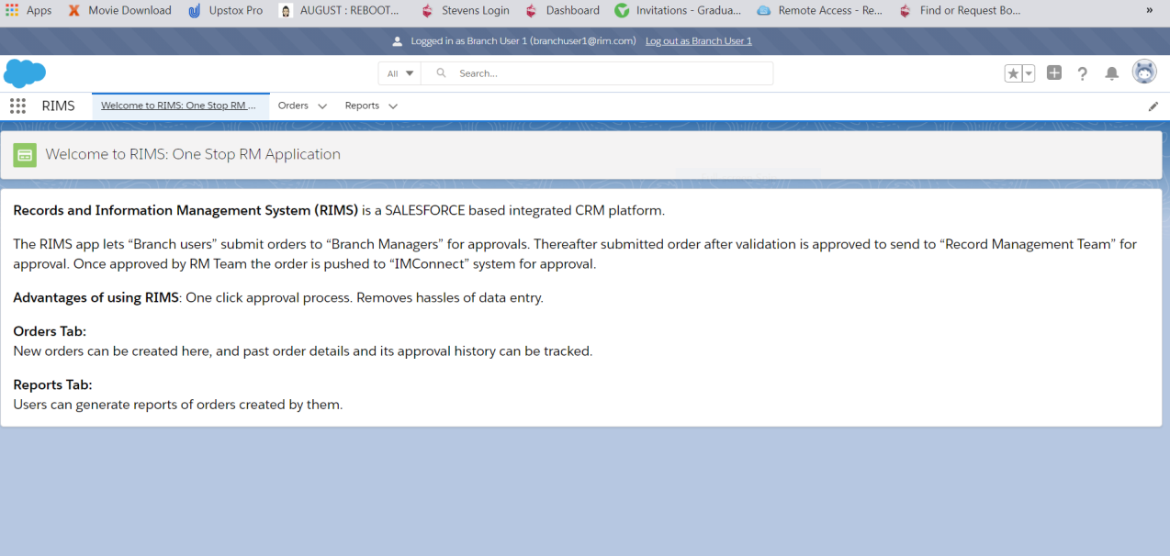
Welcome to RIMS APP
Here the user will login to SALESFORCE URL to place an order/approve any order/create their order history reports
Reengineering Homework

Slide 38
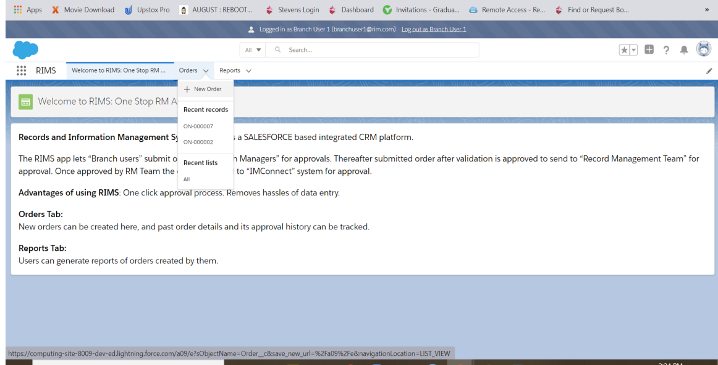
Placing new order on RIMS system
For placing a new order, click on order tab
Reengineering Homework

Slide 39
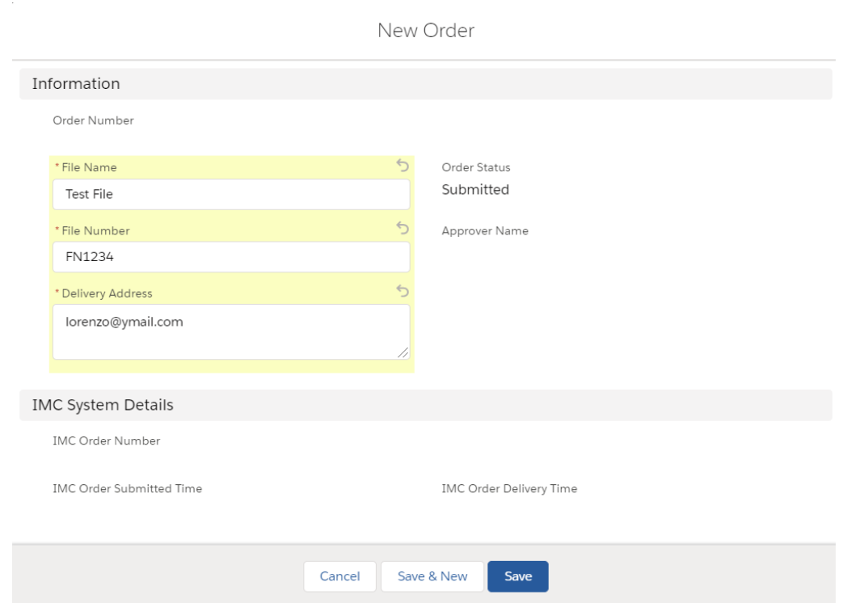
Input screen for placing the order
Reengineering Homework

Slide 40
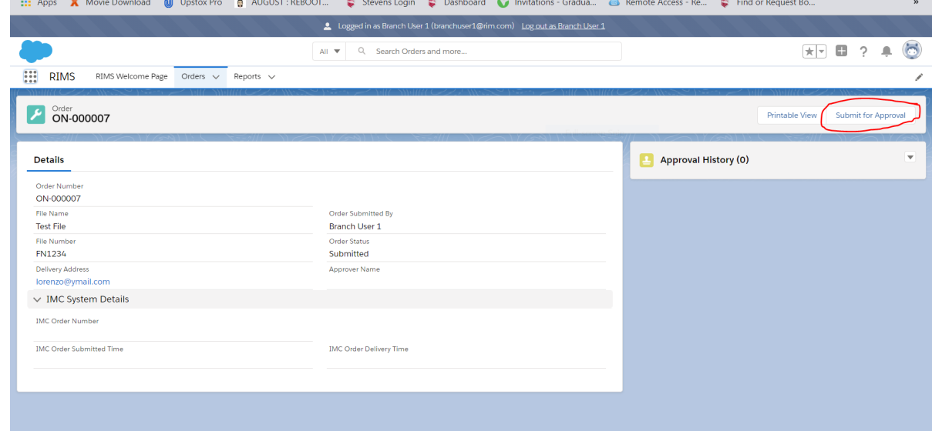
Then submit for approval to Branch Manager
Reengineering Homework

Slide 41
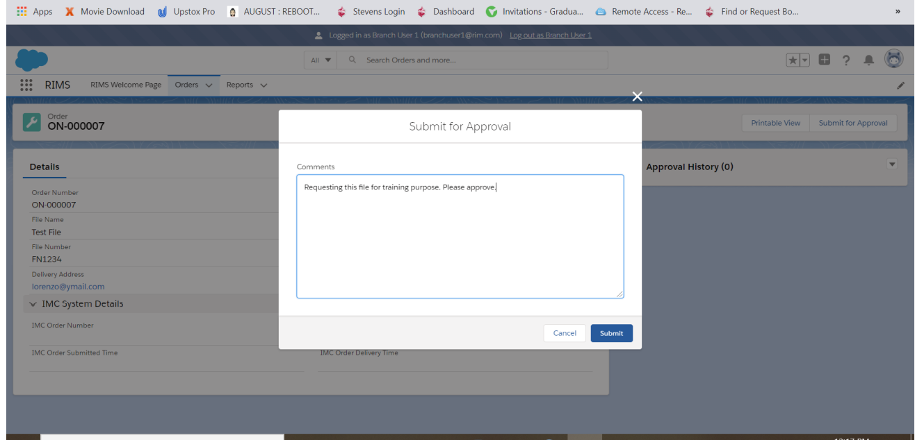
Provide relevant comments for submitting approvals.
Reengineering Homework

Slide 42
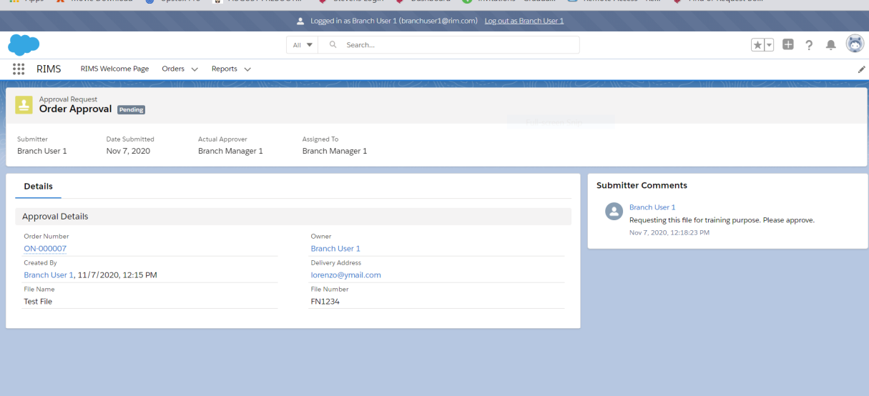
Order is sent to Branch manager for the approval
Reengineering Homework

Slide 43
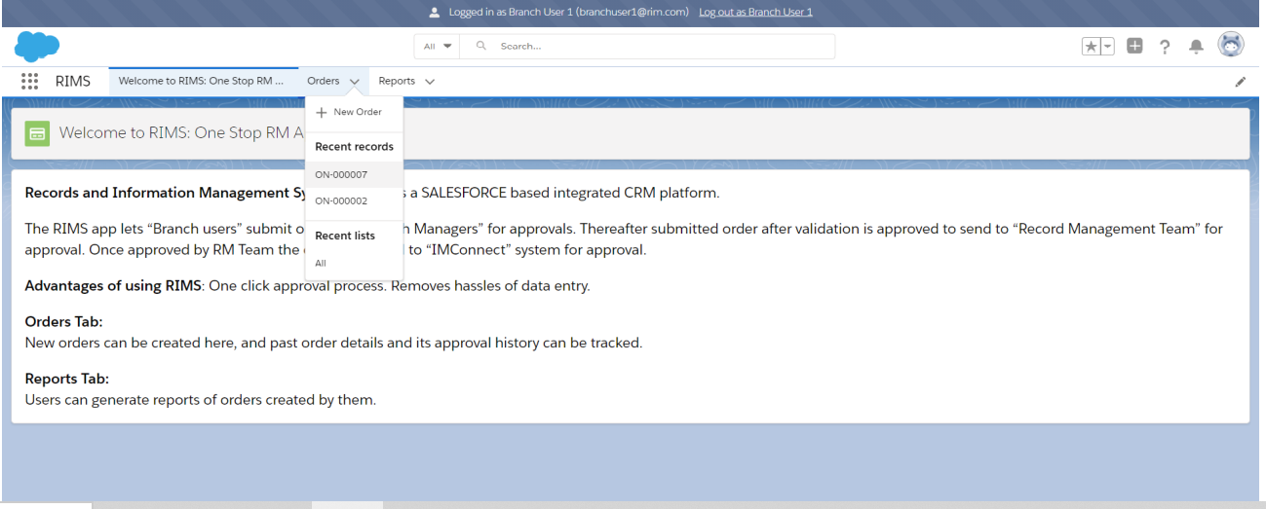
Order history can be checked by clicking the order tab:
Reengineering Homework

Slide 44
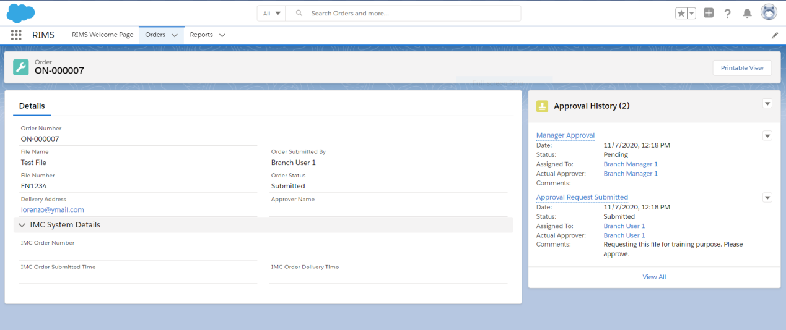
The order page looks like this and is waiting for the manager approval
Reengineering Homework

Slide 45
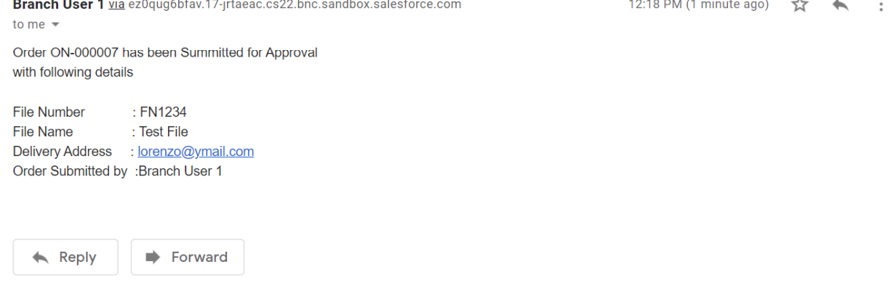
When you submit an order, an email is sent to you to advise you that it has been submitted for approval.
Reengineering Homework

Slide 46
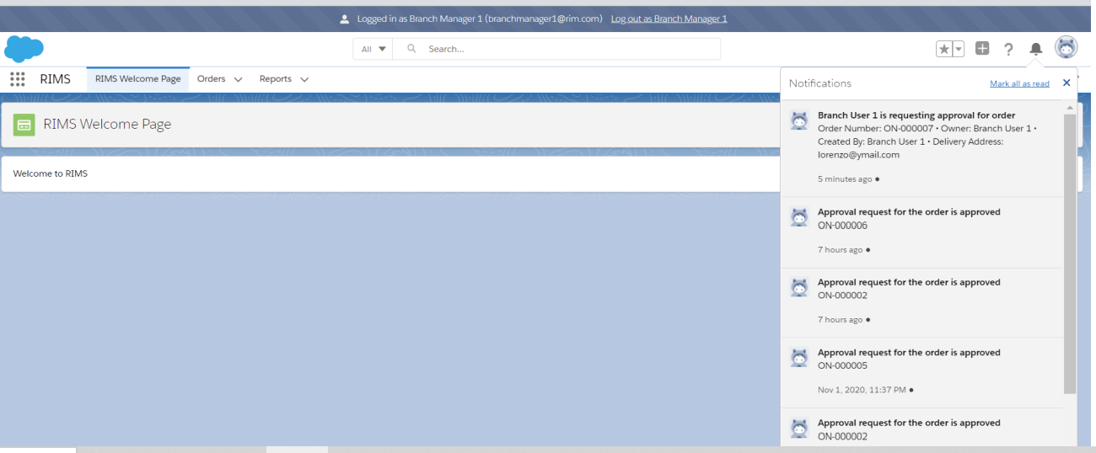
Branch Manager receives the notification for the approval
Reengineering Homework

Slide 47
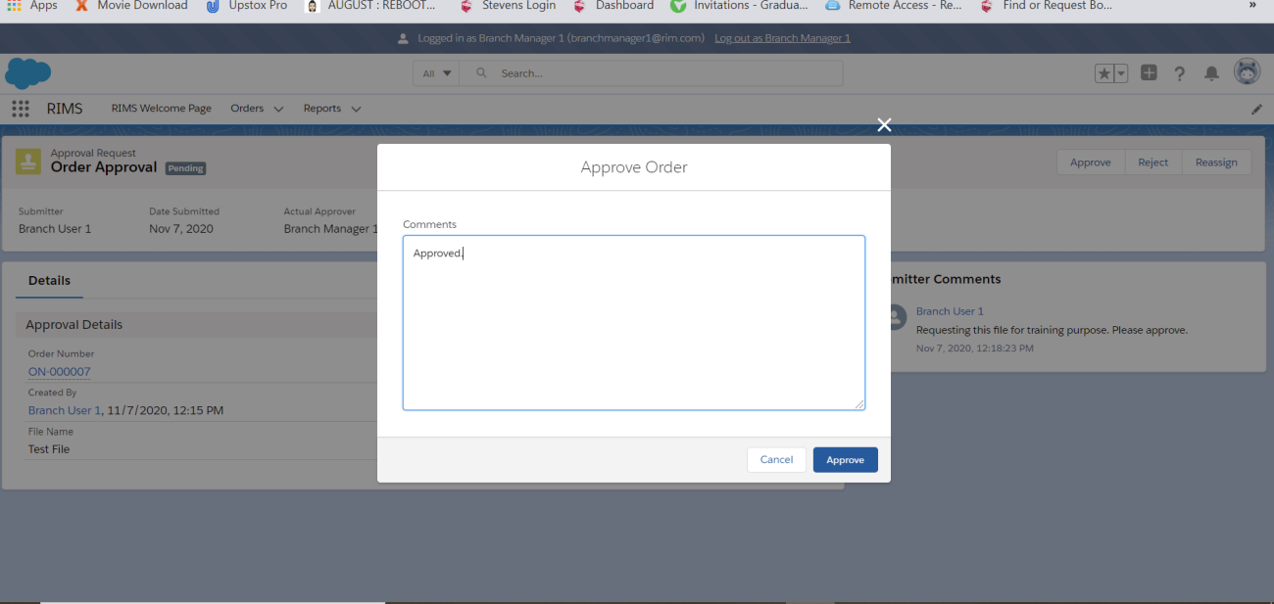
On approving the order relevant comments need to be made
Reengineering Homework

Slide 48
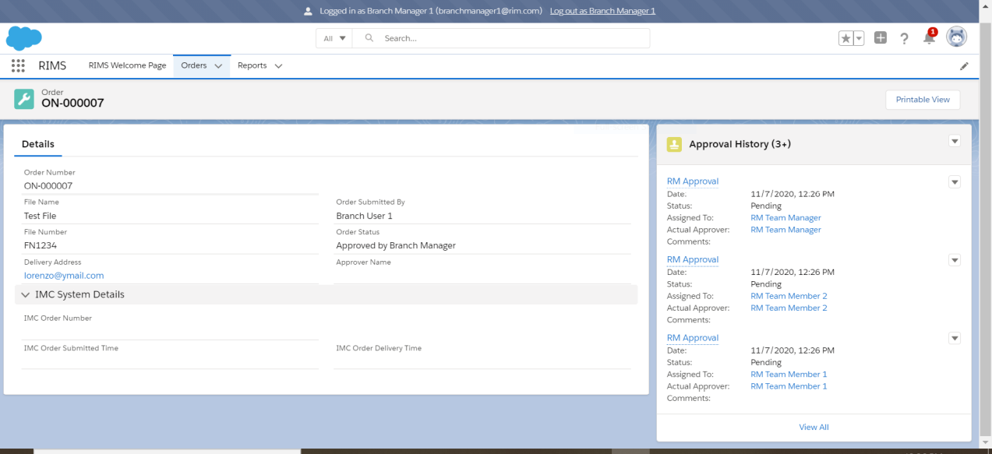
When the request is approved the request is changed to approve by the Branch Manager
Reengineering Homework

Slide 49
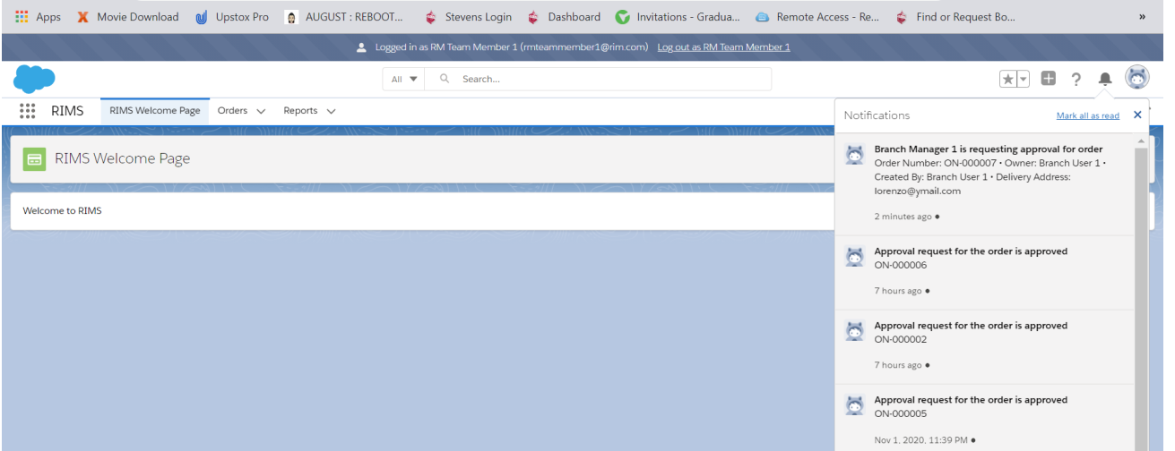
The order is instantly submitted to the next level of review, which is the Record Management team, as soon as the Branch Manager confirms it. "According to the notification tab, the Branch Manager is requesting approval for the order."
Reengineering Homework

Slide 50
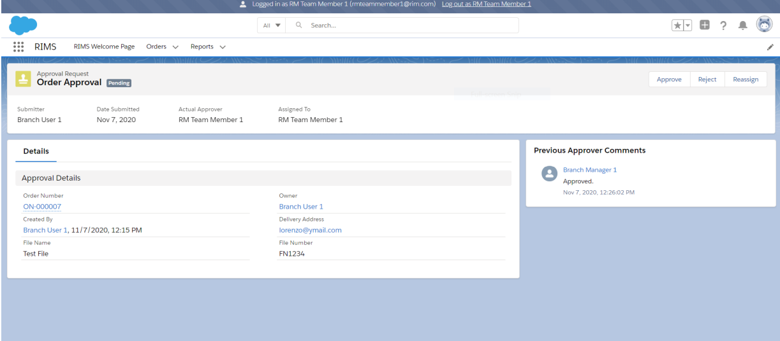
The RM team approves the request by clicking on the approve button
Reengineering Homework

Slide 51
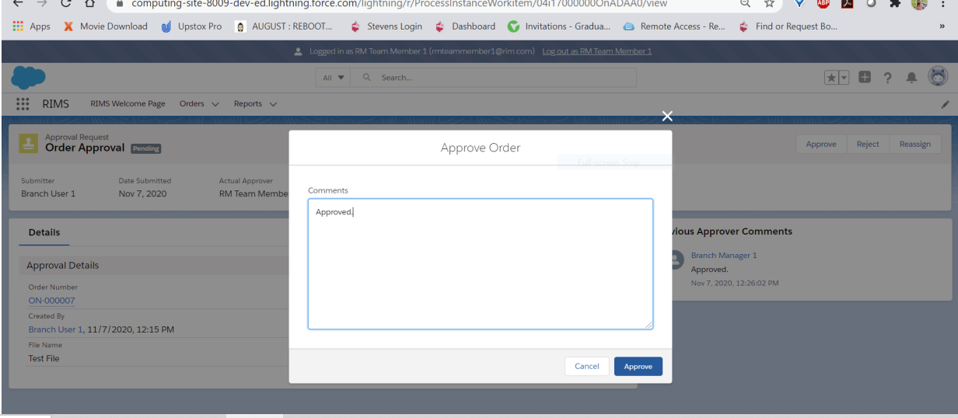
On approving the request relevant comments need to entered
Reengineering Homework

Slide 52
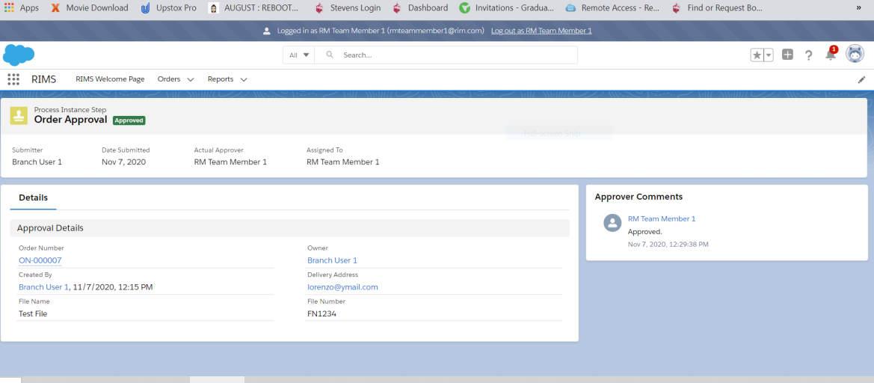
Order automatically goes to IMConnect system on approval by RM Team.
Reengineering Homework

Slide 53
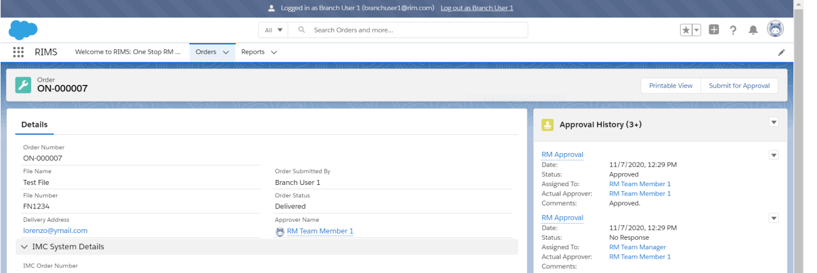
"IMC Order Delivery Time" and "Order Status" are updated whenever the order is finished by the IMConnect team
Reengineering Homework

Slide 54
THE END
Reengineering Homework

